Slide 1
ANZ Data@ANZ Program
Data analytics approach
Work Done By :Swapnil Prabhakar Wagh

Slide 2
Note: The data and information in this document is reflective of a hypothetical situation and client. This document is to be used for KPMG Virtual Internship purposes only.
Agenda
Introduction
Data Exploration

Slide 3
Introduction
DATA INTRODUCTION:
* For Analysis:
This task is based on a synthesised transaction dataset containing 3 months’ worth of transactions for 100 hypothetical customers. It contains purchases, recurring transactions, and salary transactions..

Slide 4
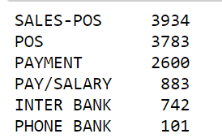
Data Quality Assessment
The given Data Have Poor Quality
* INCOMPLETNESS
Many missing values are present in dataset
* INACCURACY
column like default have unwanted script instead of proper data .

Slide 5
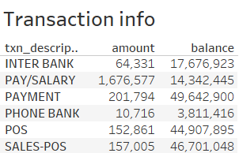
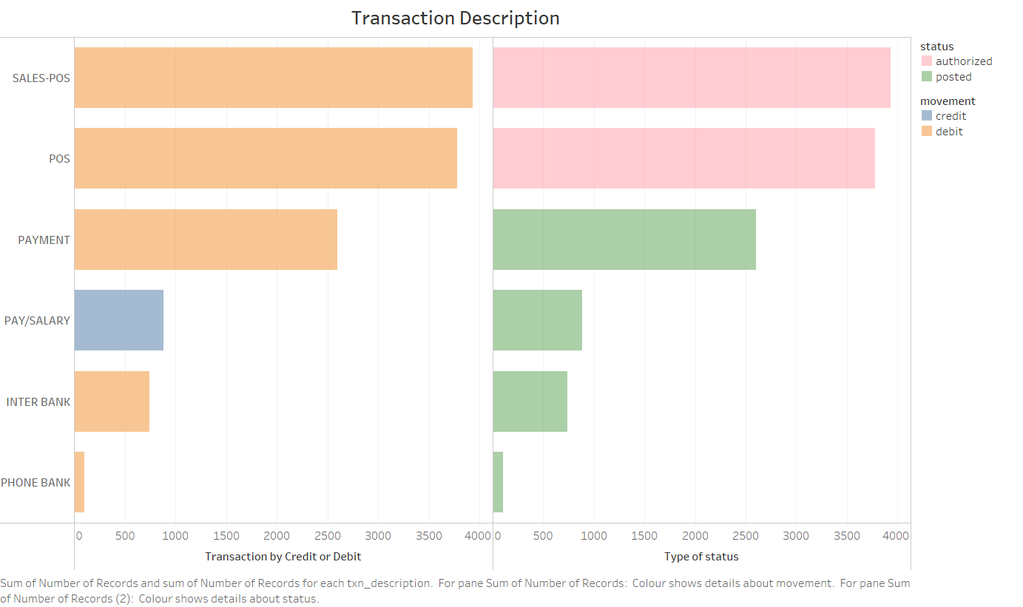
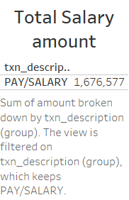
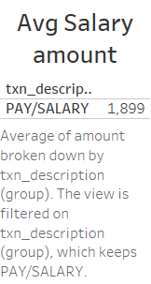
Data Exploration
Univarient Analysis:
Place any informaton about this point here.

Slide 6
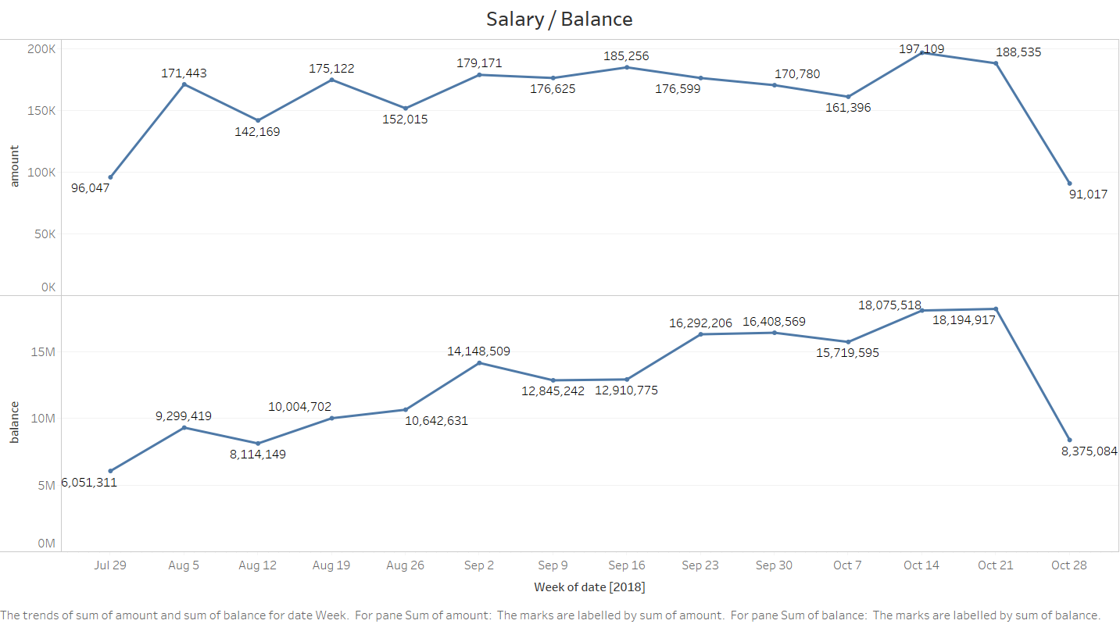
LINE PLOT SHOWING AMOUNT WEEKLY

Slide 7
THANK YOU.....

